Slide 1
Patient Monitoring System

Slide 2
Problem Statement – Patient Monitoring System
Hospitals and caregivers struggle to continuously monitor multiple patients, especially in critical cases.
Manual recording of patient vitals such as heart rate ,temperature blood pressure and oxygen levels leads to human error and delayed response.
There is no centralized digital platform for real-time tracking and alerts.
Increasing chronic diseases and aging population require remote and efficient monitoring.
Our solution: A digital patient monitoring app that ensures timely intervention and continuous care.
The PMS also provides continuous tracking and alert generation for abnormal conditions, ensuring faster response and improved patient safety.
Typical customers include: hospitals, home healthcare providers, elderly patients needing continuous observation, and post-operative care patients.

Slide 3
Patient Monitoring System – Product/Solution (Innovation)
A digital health monitoring app that tracks, records, and analyzes patient data in real time.
Type of Innovation:
Incremental Innovation: Improves upon existing health-tracking apps by combining monitoring, alerting and doctor connectivity in one unified platform.
Bridges the gap: Unlike generic fitness or health apps, it is tailored for post-operative, elderly and chronic-care patients.
Key Features:
• Real-time digital dashboard for doctors and caregivers
• Health history visualization and trend analysis
• Smart alerts for abnormal readings
• Multi-user access (Doctor, Patient, Family)
• Secure cloud-based storage and analytics
Uniqueness: Affordable, simple, and scalable platform focused on hospital and home care environments.
Simplifies health tracking , Instant alerts, 24x7 accessibility, Data visualisation(through interactive charts and graphs for easy understanding)

Slide 4
Patient Monitoring System – Readiness Level
Stage:
Our product is currently in the Ideation and Wireframe Design stage, where the concept and structure of the Patient Monitoring System are being validated through customer research and prototype design.​
Current Functionalities:
• Patient registration and health data management
• Abnormal alert notifications
• Doctor dashboard and digital reports
• Cloud integration and secure data storage
Next Steps:
• Integration with hospital management systems
• Predictive analytics and AI-based insights
Ideal Users: Hospitals, clinics, elderly care centers, and individual patients.

Slide 5
Team Size, Background, Strength & Resources
Team Members:
• App Developer – Frontend & Backend Development
• Data Engineer – Cloud and Database Management
• Designer – UI/UX and Interface Development
• Project Lead – Domain Research & Testing
Strengths:
• Skilled in health-tech app development
• Strong understanding of healthcare workflows
• Agile team with cross-domain collaboration.

Slide 6
Market Landscape – Market Potential & Competitors
Digital Health Monitoring Market:
• Global market projected to reach $370 billion by 2030
• Rapid adoption of telehealth and remote monitoring
Competitors: HealthifyMe , Practo, MyChart
Our Advantages:
• Real-time doctor-patient connectivity
• Customizable for small hospitals and clinics
• Cost-effective and analytics-driven design.

Slide 7
Business Model & Strategy
Revenue Model:
• Freemium version for individuals
• Subscription plans for hospitals and clinics
• Add-on analytics and reporting services
Distribution Channels:
• App stores (Android, iOS)
• Hospital partnerships and telemedicine platforms
Growth Strategy:
• Pilot projects in hospitals
• Regional expansion through collaborations
• Digital marketing via healthcare networks.

Slide 8
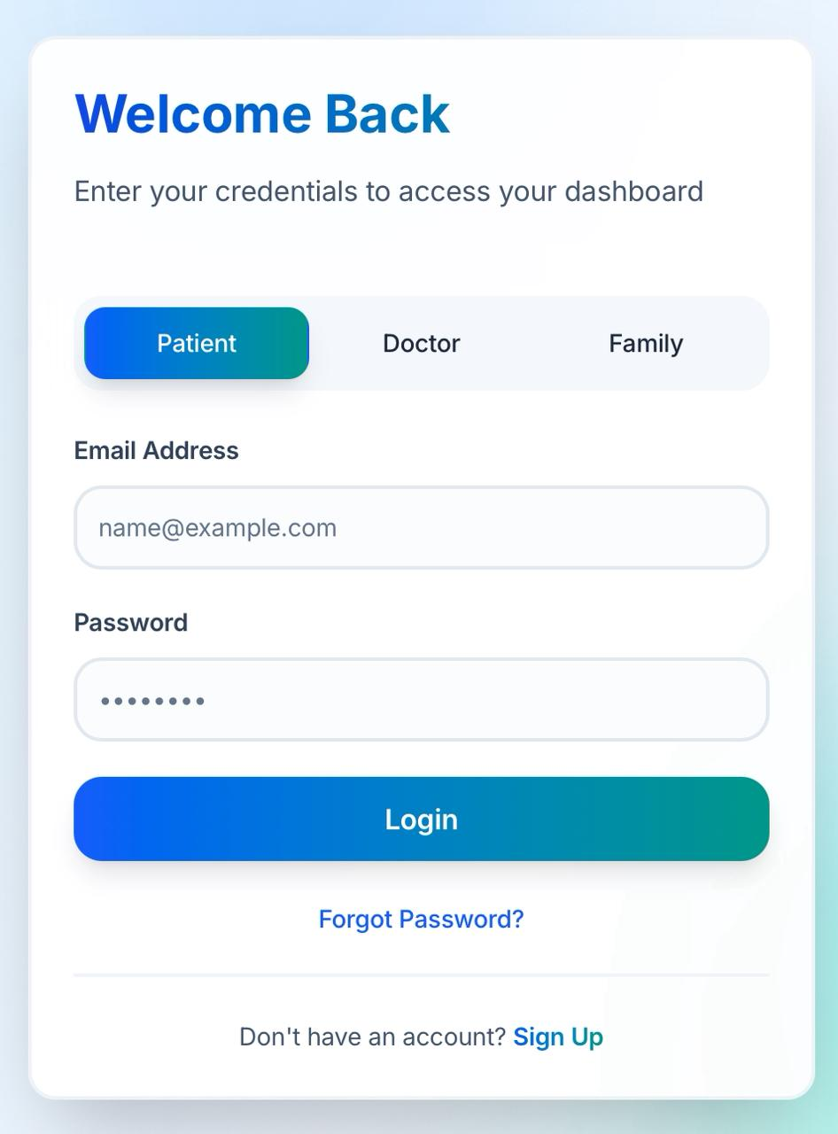
How the Front-end works
This is the login page for Patient Monitoring System, designed to simplify patient monitoring. ​
Key Elements:​
​
1. Title: "Welcome to Smart Digital Health Monitoring" ​
​
2. Login Section:​
-Email/Username: Input field (example: name123@gmail.com).​
- Password: Masked input field.​
- Role: Dropdown set to “Patient".​
​
​
3. Actions:​
- Login: Blue button to submit credentials.​
- Sign Up: Option for new account creation.​
- Forgot Password?: Link for password recovery.​
​
​

Slide 9
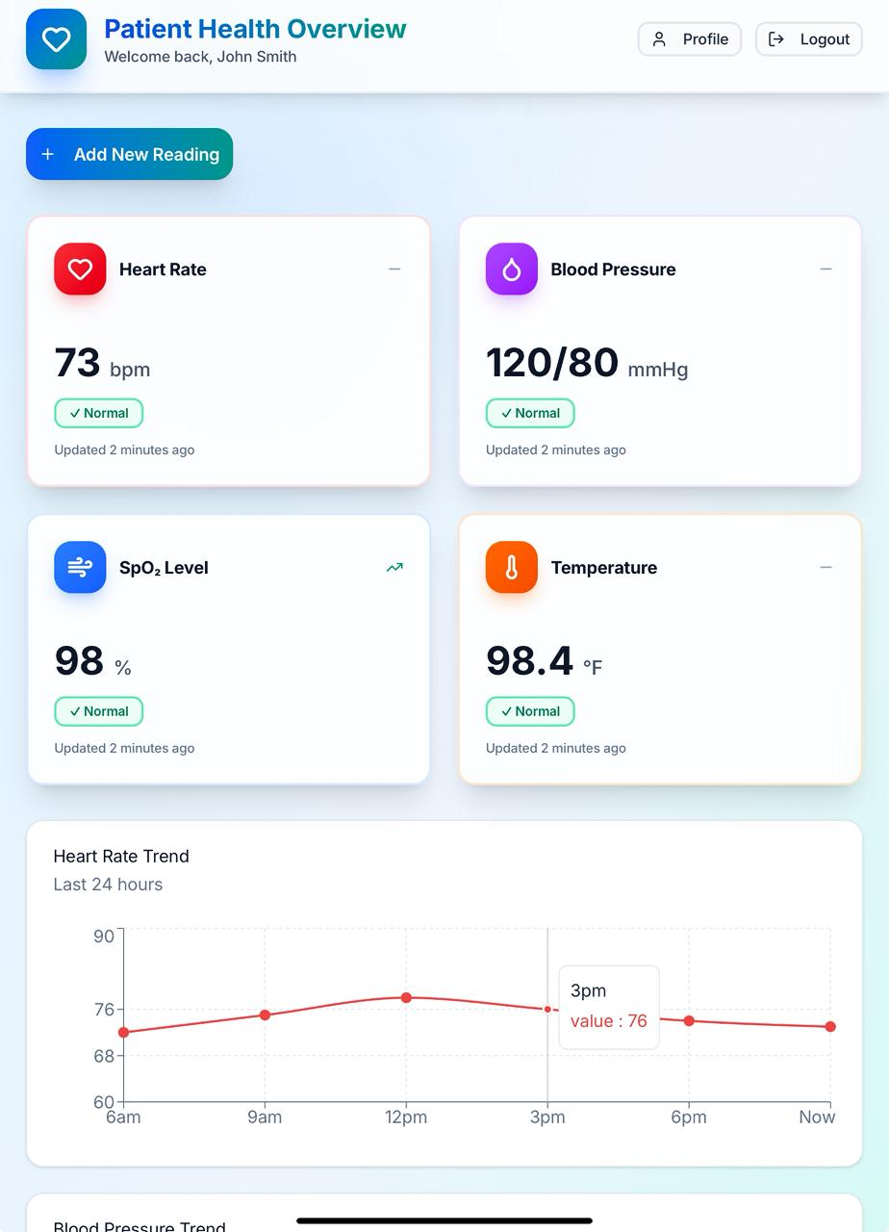
How front-end works
This screen is the Patient Health Overview
Dashboard - the main page a user (like a doctor, caregiver, or patient) sees after logging into the app.
It shows all vital health readings in one place things like:
Heart Rate
Blood Pressure
SpO, Level (oxygen saturation)
Body Temperature
Each of these boxes updates with the latest reading and tells whether the value is Normal or Abnormal.

Slide 10
Total Budget, Required Support & Regulation
Type of Support Required for Final Product Launch​:
Technical support:
Cloud Infrastructure: Hosting support for backend servers, databases, and real-time data storage (e.g., Firebase, AWS, or Azure).
App Development Mentorship: Guidance from industry experts or professors for advanced features such as AI-based anomaly detection and alert optimization.
• Institutional grants and cloud credits
• Partnerships with healthcare providers.
Partnership and Industry Support:
- Partnerships with local clinics, hospitals, or home-care agencies for pilot testing and real-world validation.
- Collaboration with IoT or wearable device manufacturers to integrate data automatically into the app.
- Networking with AI health startups or NGOs for expansion and community use.

Slide 11
Conclusion
The Patient Monitoring System is a digital health platform designed to make healthcare proactive.
It ensures continuous monitoring, real-time alerts, and AI-driven insights to prevent emergencies.
This system empowers both patients and doctors, enhancing healthcare delivery through innovation.
The Patient Monitoring System thus aims to enhance healthcare efficiency, reduce human errors, and ensure timely medical interventions through smart technology.

